Slide 1
FMC v1.0 Introduction
Yamei Zhou
04/25/2016

Slide 2
FMC 1.0
FMC stands for “Fix Management Center”. It’s a system designed to centrally and systematically manage SEG fixes/releases (Hot Fix/ Patch/ Service Pack) which can help to reduce the human errors on merge list maintenance. This system will help Support/Core team easily search/trace the specific release history/status for internal or external inquiries.

Slide 3
Functions
Submit(only available to SEG Manager)
Modification(only available to RD team-SEG manager/Team Leader)
Project Statues(only available to RD team)
Search
Admin

Slide 4
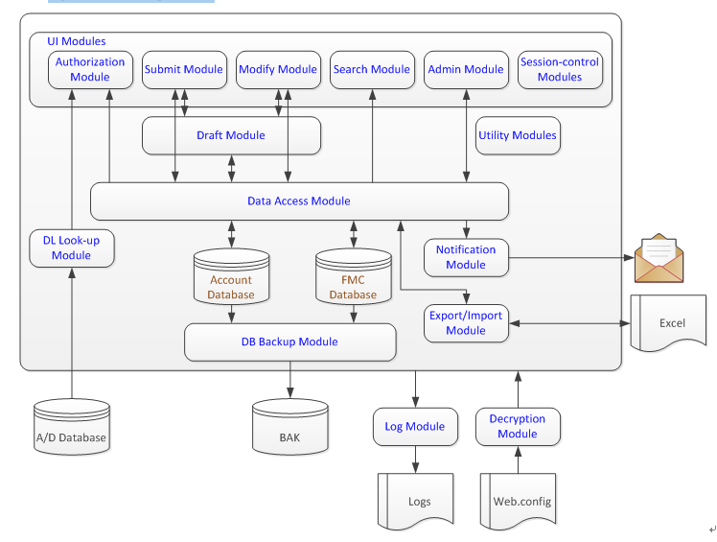
System Diagram

Slide 5
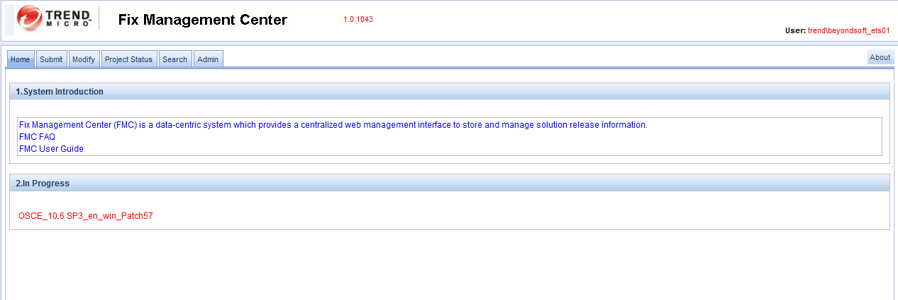
Home
- System Introduction:
This is introduction for FMC system panel

Slide 6
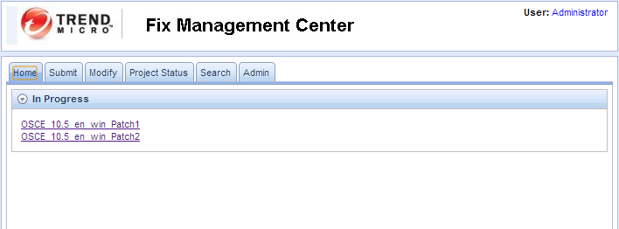
- In Progress: list all projects that haven’t finish the whole process (Only see his own process). End user can click the link to continue to finish the process. (not done)

Slide 7
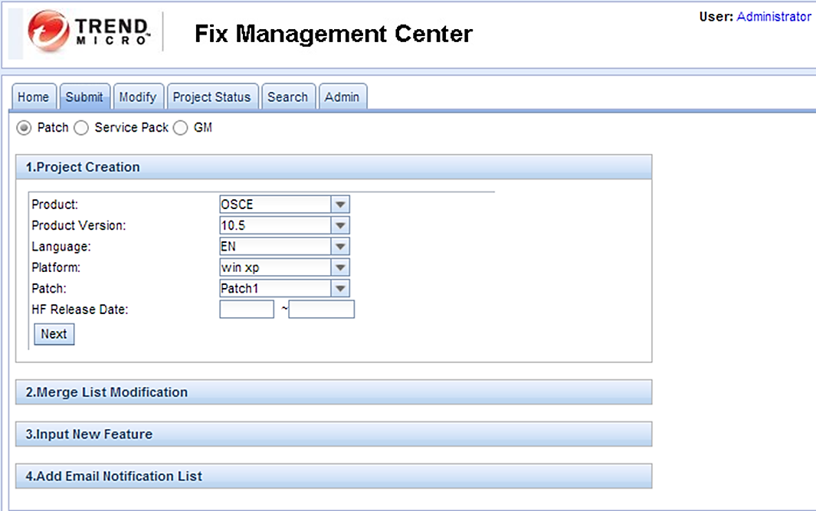
Submit
1. Create Project:
-Patch : Generate the Project Name according to language and Patch value
-Service Pack: Only Product Version Field is different to Patch Function
-GM
“Input New Feature” filed is required/mandatory in “SP” and “GM” release type

Slide 8
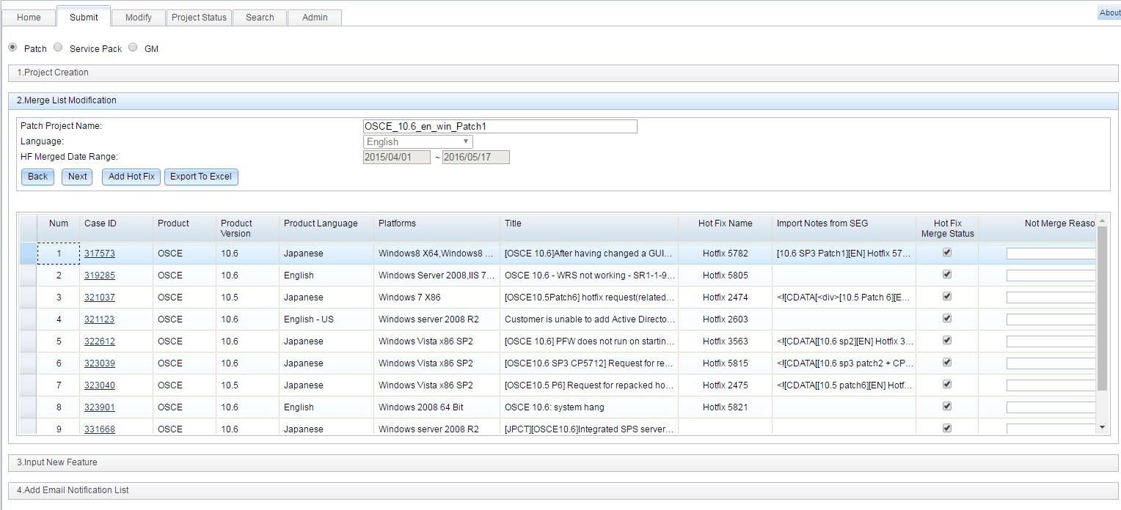
2. Merge list modification
select all checkbox by default. User can remove the selection if they want, but they need to input the Not merge reason for these.
Case list need to remove all cases that have been included in other Patch.
User also can add more case in table via [Add Hotfix] button.

Slide 9
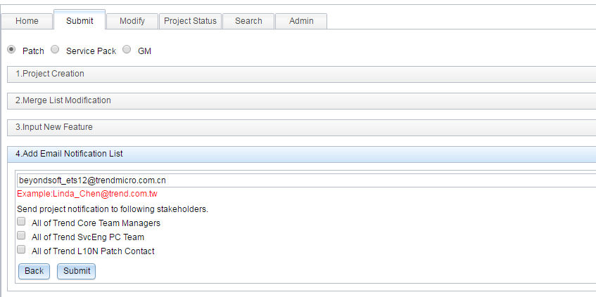
3. Add Email Notification List

Slide 10
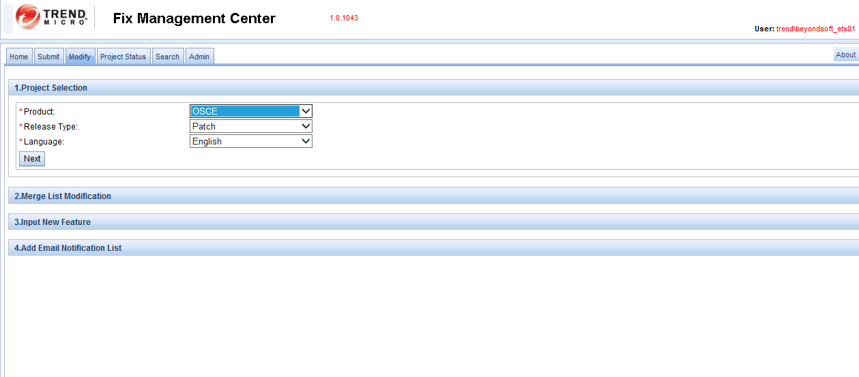
Modify
Most business logic is the same as submit function.
Add/remove the case mapping info to relational table directly

Slide 11
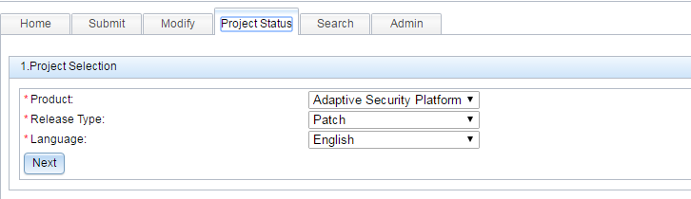
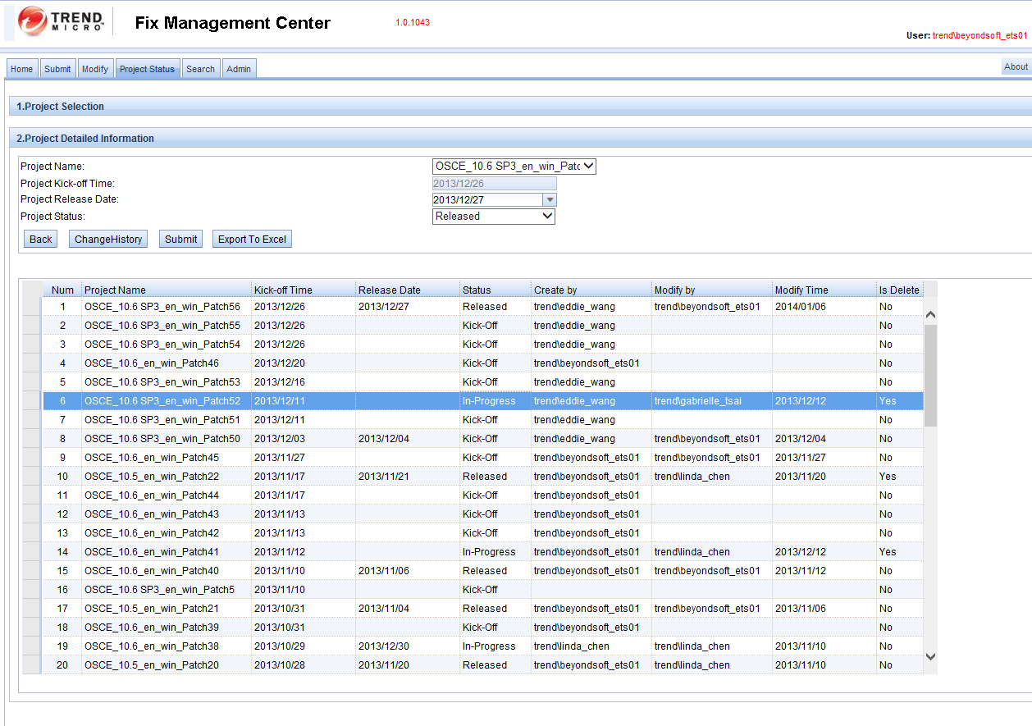
Project Status

Slide 12
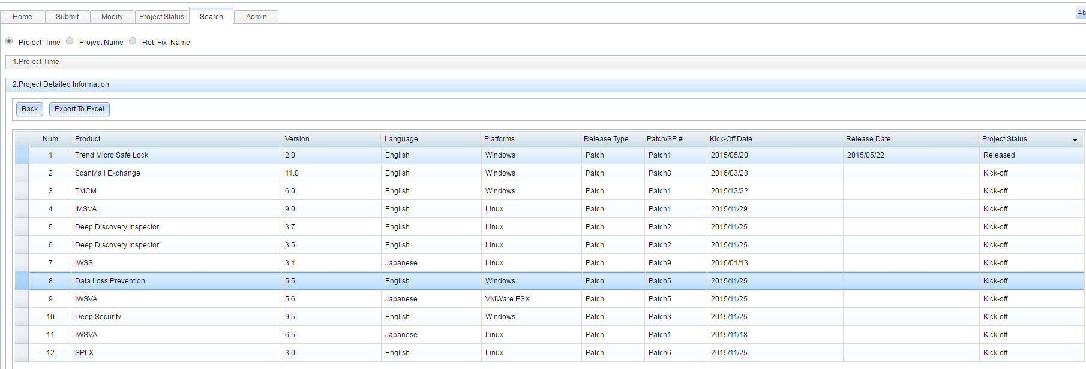
Search
—Project Time
—Project Name
—Hot Fix Name
—Change History Query

Slide 13
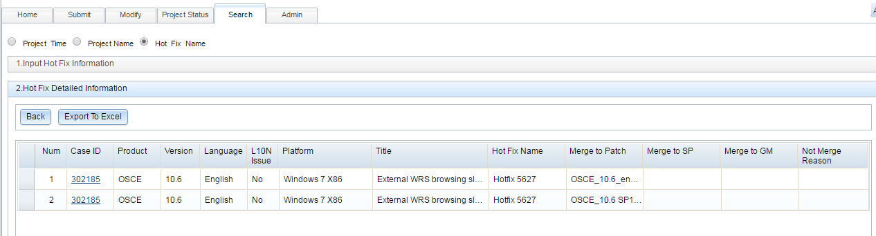
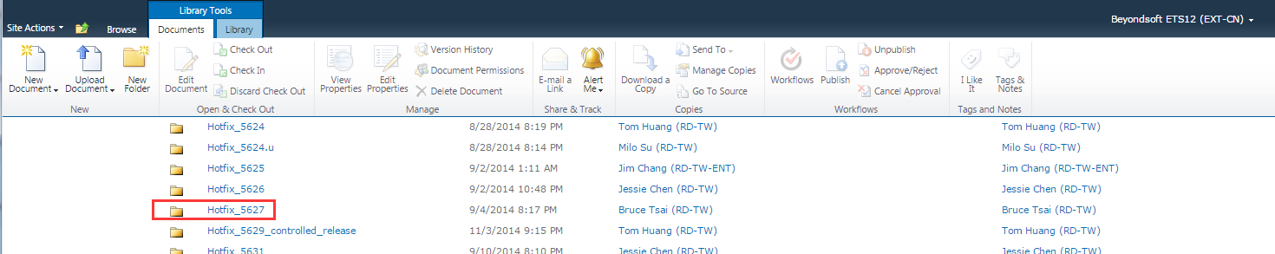
When users click “Hot Fix Name”, it will automatically connect to SEG iShare Hot Fix Download folder for users to download the Hot Fix package from there.(not done)

Slide 14
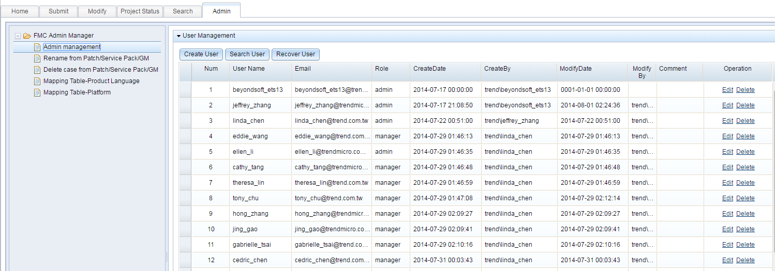
Admin

